Slide 1
Analysing amazon sales data

Slide 2
INTRODUCTION
Purpose: Analyzing Sales-trend -> month-wise, year-wise, yearly_month-wise.
Source of Data: Amazon sales data
Methodology: Visualization using Power BI

Slide 3
DETAILS OF THE DATASET
Dataset: “Amazon Sales Data"
Columns:
Region
Country
Item type
Sales Channel
Order Priority
Order date
Order Id
Ship Date
Unit Sold
Unit Price
Unit Cost
Total Revenue
Total Cost
Total Profit

Slide 4
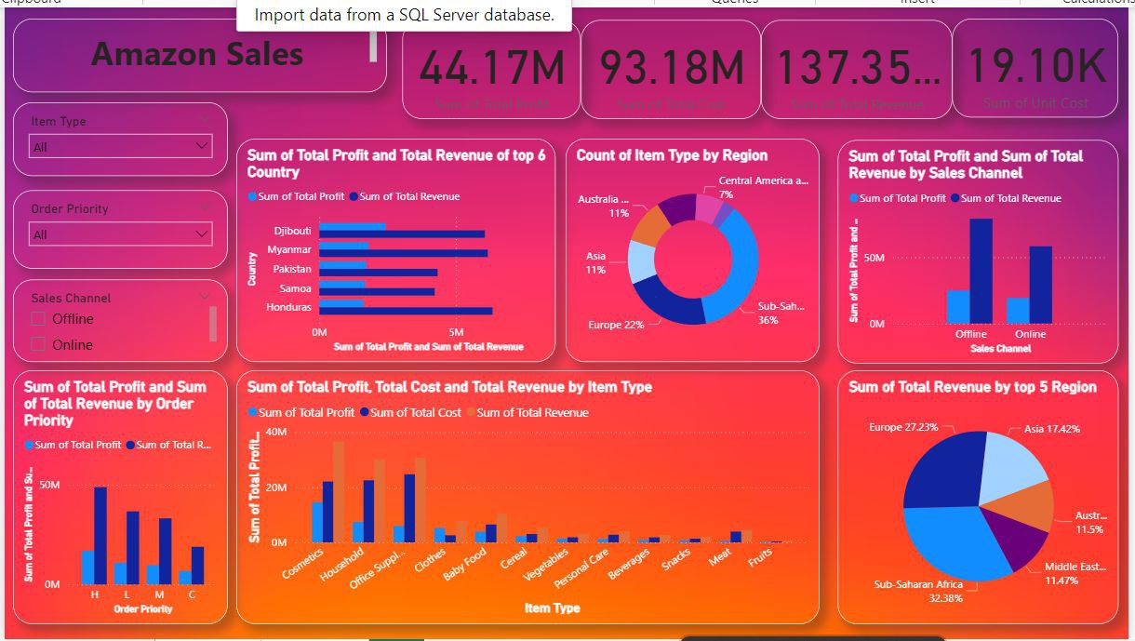
DESIGNED DASHBOARD

Slide 5
THANK YOU
PPt By:- Anshul Yadav

